Slide 1
Welcome to the Symphony of Education: navigating Leadership Levels

Slide 2
What is Educational Leadership?
School or educational leadership is the process of enlisting and guiding the energies of teachers, pupils, and parents ,coordinators, principals and directors towards achieving common educational aims.

Slide 3
Leadership is not about being the best. Leadership is about making everyone else better.

Slide 4
Who are the leaders in the world of education that could represent the Levels of leadership?

Slide 5
Principals
Teachers
Leaders
Coordinators
Managers

Slide 6
Five levels of leadership

Slide 7
What are the five levels of leadership?
permission
production
position
Levels of Leadership
People’s Development
pinnacle

Slide 9
What are the advantages of this level?(position)
*Granted to people who possess the skills needed for leadership
* Giving the leader the power and authority to perform his /her work
* Enabling the leader to develop his/her leadership skills
*Enabling the leader to determine the appropriate style that helps him/her to create changes

Slide 10
What are the disadvantages of this level?(position)
*Imposing false respect and artificial appreciation
*Relying on position, a leader may reduce the value of the employees creating a work environment that suffers from values and ethics
*Transforming the work environment into political one based on the ability to control conflicts
* Prioritizing rights over duties and responsibilities

Slide 11
The positive practices of the educational leader at this level :Permission

Slide 12
1-Getting to know and communicate with himself/herself before getting to know the others and communicate with them
Let’s talk!

Slide 13
2-Adopting a leadership style based on human relations, a style that is not managed by regulations and punishments, but by human touch

Slide 14
3-Following the golden rule:

Slide 15
4-Being a motivator and inspirer for employees:

Slide 16
5-Creating a balance between interests and frankness: caring about employees and giving them feedback on their level of work completion frankly and accurately

Slide 17
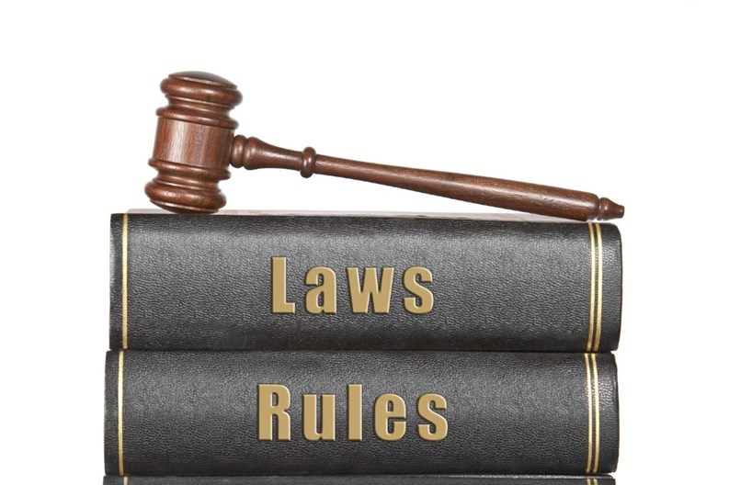
Laws of the third level of leadership:
Production
8 laws

Slide 18
Law of respect: Receiving respect because the leader deserves it for what he/she does
Law of attraction: attracting productive workers
Law of Image: Becoming a role model to increase the productivity of those working with him/her
Law of Victory: bringing victory and success to his/her team and the organization

Slide 19
Law of Momentum: creating a series of achievements that help the organization overcome challenges and weaknesses
Law of Priorities: Knowing what to accomplish ,how, when and why
Law of sacrifice: Learning to give up many advantages to bring the organization to the top
Law of purchase: Building good relationship with employees and valuing what they are keen on

Slide 20
The Characteristics of the fourth level of leadership: People’s development

Slide 21
Attracting productive workers who possess the skills from the beginning
Appointing workers in jobs appropriate to their skills and capabilities
Investing time, effort and money to develop them and grow them professionally while providing them with support
Spreading the culture of leadership in the organization
Making the development of others a life commitment not work commitment

Slide 22
Fifth Level of Leadership: The Pinnacle
Realizing that the leader still has a lot to learn
Maintaining, focusing and enhancing hi/hers strength
Carefully choosing the closest circle so that it can share his/her vision and achieve hi/hers goals
Accomplishing what can be accomplished for the institution
Creating space for others at the top, a space to develop other leaders paying attention to training and developing their leadership
Planning for the legacy that he/she will leave in terms of achievement and development
Making success a basis for achieving loftier goals outside the scope of work

Slide 23
Roles and Duties

Slide 24
The teacher: a leader in the light of the five levels of educational leadership
Position | Permission | Production | People’s development | Pinnacle
Teaching books and not students Students are obliged to learn The result is failure | Building relationship with students Students would accept to learn, but the teacher’s weak skills in teaching would not be helpful | Students learn because of the skills teachers have developed and helped transfer these skills to the learners | Teachers are helping Students develop their personalities by matching what is taken in the class to their real life | Becoming a model to be followed by students for the great influence he has on their lives

Slide 25
The Coordinator: a leader in the light of the five levels of educational leadership
Position | Permission | Production | People’s development | Pinnacle
Teachers follow the coordinator because they have to fake acceptance and respect | The coordinator is accepted by teachers for the good relationship he/she has, or for his/her kindness, good treatment to the teachers | Teachers follow the coordinator because of what he/she has done for them Adaptation to the curriculum Transferring the skills needed to teachers to be more productive | Coordinators Choose and develop teachers for better changing They Prepare them to be coordinators | Coordinators are good influencers to many teachers Teachers are ready to be coordinators

Slide 26
The Principal: a leader in the light of the five levels of educational leadership
Position | Permission | Production | People’s Development | Pinnacle
*Applying the school rules because they have to *Neglecting others’ rights *Breaking up to these rules by learners | *The principal balance between the school rules and people’s rights *Accepted by the others | *The principal cares for people more than caring for the rules that hinder productivity *Productive workplace | *following the rules that guarantee people’s development *Drawing the attention to points of power to be developed | *becoming an influencer to learners and teacher *People follow a reference who is able to solve problems and make changes in their lives

Slide 27
The director: a leader in the light of the five levels of educational leadership
Position | Permission | Production | People’s Development | pinnacle
People follow him because they have to | People follow him because they want to ( good relationship, permissive, not picky……..) | People follow because of what he/she has done for the organization | *People follow because of what he/she has done personally *Innovator *hard worker *preparing the others to be leaders | People follow because of who he/she is and what he/she represents

